Slide 1




Starting Now
Interpretability by Design: Exploring Rule-Based Models in ML
Rule-based models, like decision trees, offer a unique advantage in interpretability by aligning closely with human reasoning.
But decision trees are just a starting point. There’s a rich ecosystem beyond standard decision trees—including rule sets, rule lists, and rule trees—each with trade-offs between simplicity, coverage, and comprehensibility.
Serg Masís
Principal AI Scientist
Pg: 1

Slide 2

Interpretability by Design
Exploring Rule-Based Models in Machine Learning
Notes:
Welcome everyone to this presentation on interpretable machine learning through rule-based models. Today we'll explore how decision trees and related models provide not just accurate predictions, but clear explanations of their reasoning process. This is increasingly important in domains where we need to understand and trust our models' decisions.

Slide 3

About Serg Masís
Principal AI Scientist @ Syngenta, a leading agribusiness company with a mission to enhance global food security, working on AI-driven decision-making tools for farmers.
Co-founded a recommendation engine startup, incubated by Harvard Innovation Labs, that combined the power of cloud computing and machine learning with principles in decision-making science to expose users to new places and events efficiently.
Author of the Bestselling Packt book “Interpretable Machine Learning with Python” and co-author for the upcoming “Building Responsible AI with Python” with Dr. Ali Al-Sharif and Nicholas Schmidt.
Serg Masís
Principal AI Scientist
Pg: 3

Slide 4
Agenda
01
Introduction & Motivation
02
Case Study with Trees
03
Beyond Trees
04
Practical Considerations

Slide 5
POLL TIME!

Slide 6

POLL
Are you familiar with the Titanic Dataset?
□ Yes
□ Only the movie
□ Neither
Please answer in the side panel!
>
Pg: 1
Pg: 6

Slide 7
Section 01: Introduction & Motivation

Slide 8
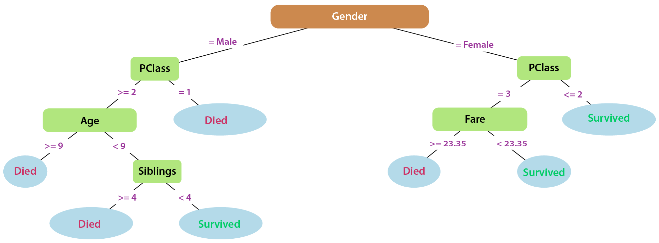





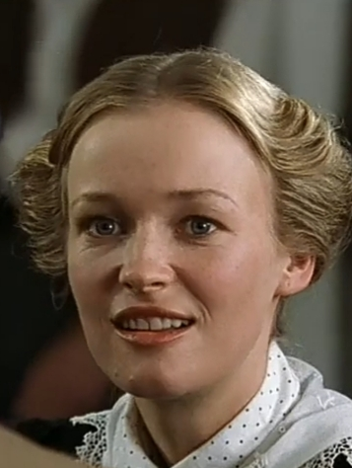
Introduction & Motivation
Decision Trees Mirror Human Logic
Like a Flowchart
Follows IF-THEN rules
Includes local decision paths
TREE TRAINED WITH TITANIC REAL-LIFE DATA
CAL
ROSE
JACK
IRISH
MOMMY
HELGA
>
Pg: 8
Notes:
At its core, a trained decision tree is a map. In this case, we have a decision tree for determining who survived the sinking of the Titanic based on real-life data of all passengers. You start at the top, at the 'root node,' which is the single question the model found to be the best first splitter of the data. Based on your answer, you follow a 'branch' to the next question. You continue this process until you reach a 'leaf node'—a point with no more questions, only a final prediction. The beauty of this is that for any prediction, we can follow the exact path taken and see the chain of reasoning. Let's break down the structure of this tree, based on fictitious characters from the movie. It’s a love story between wealthy Rose, who is a first-class passenger and indeed survives, and Jack, who is a third-class passenger and, SPOILER ALERT, does not. Even though they fall in love on the boat she is engaged to, first class passenger, Cal who doesn’t survive either. According to the decision tree if you are male you are not likely to survive unless you are a child under the age of 9 with less than 4 siblings. In the movie, there are several unnamed characters that fit that description and survive. On the female side of the tree it’s the first and second class passengers that survive and if you are third class, the best predictor if you survived was whether if you overpaid for your fare. In the movie the character Helga seemed to pay more for her fare whereas the Irish Mommy probably paid a low fare. In the movie both don’t survive but historically any third class female that paid a low fare would had survived.

Slide 9
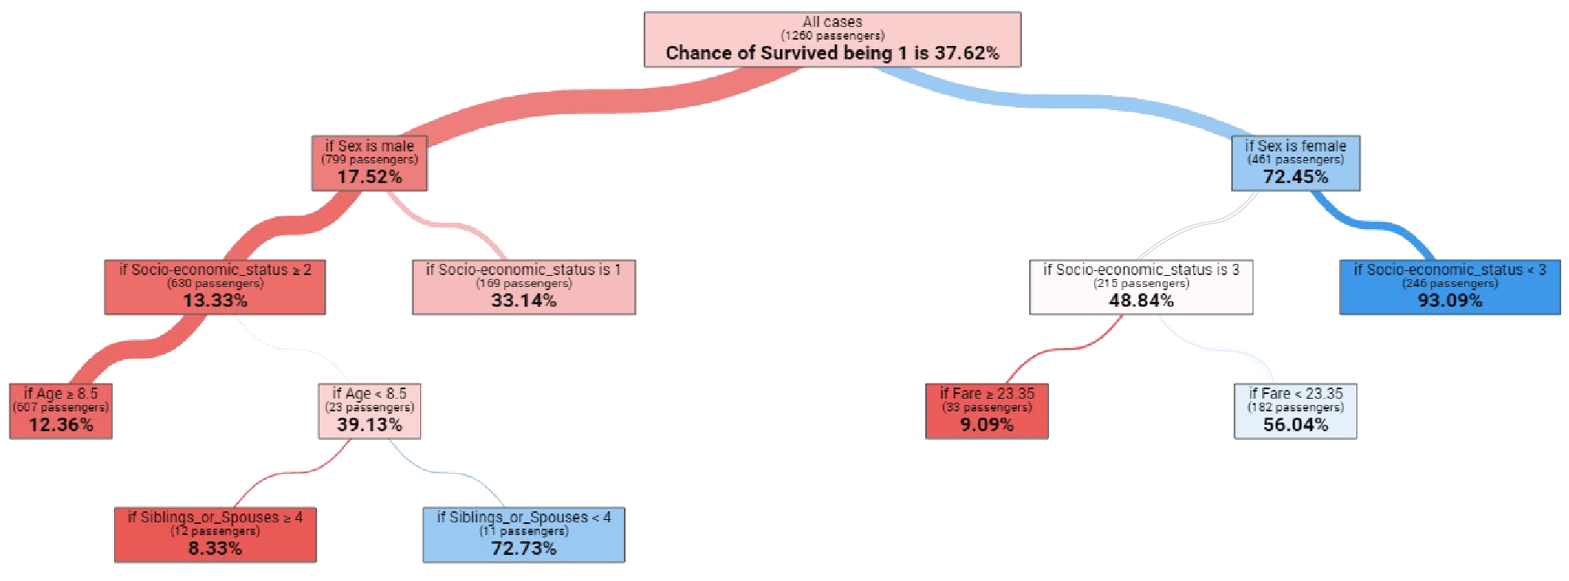
Introduction & Motivation
Machine Learning Decision Tree Algorithms Optimize on Outcomes
Using real-world outcomes
Learns the optimal splits and thresholds
To determine predictions
>
Pg: 9
Notes:
So, how does the tree make decisions from the root node down the branch splits to the very last leaf node? The machine learning algorithm choses optimal splits based splitting a feature on specific thresholds contrasts the outcomes on one branch versus the other. For instance, gender is great root not split because in general females are 72% likely to survive whereas males are only 17.5% likely Then it finds other feature threshold combinations that create the greatest difference in outcomes, like first instance first class females being 93% likely to survive while other females only 49%.

Slide 10

Introduction & Motivation
Defending the Humble Decision Tree
>
Pg: 10

Slide 11
Introduction & Motivation
Defending the Humble Decision Tree
>
Pg: 11

Slide 12

Introduction & Motivation
Model = Mathematical Function
>
Pg: 12

Slide 13
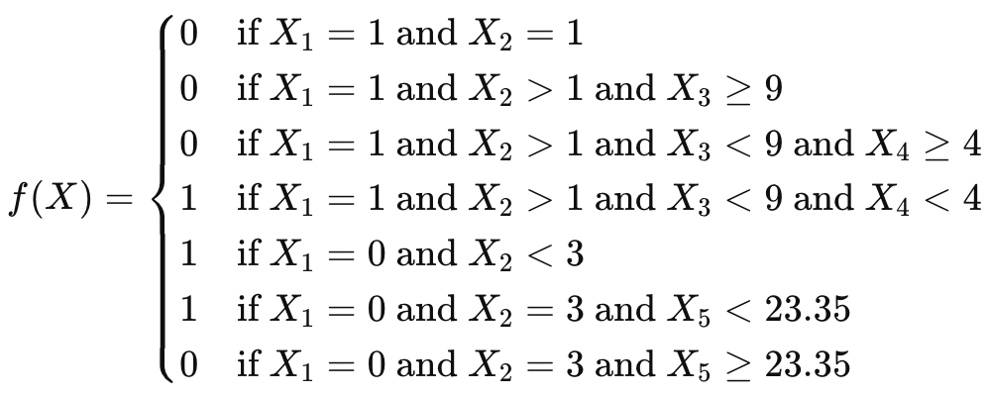
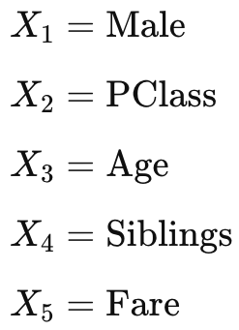
Introduction & Motivation
Model = Mathematical Function
:
Learned parameters
>
Pg: 13

Slide 14
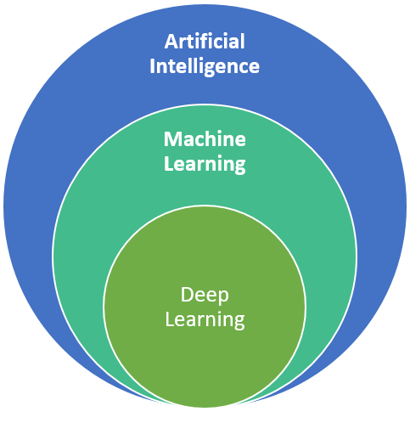
Introduction & Motivation
Decision Tree ∈ Machine Learning ⊆ AI
Decision Trees
Linear
Regression
Naïve Bayes
Large Language Models
Convolutional Neural
Networks
>
Pg: 14
Notes:
Mention how LLMs don’t have: - causal mechanisms - a working memory - a physical understanding of the world - a way to evaluate its outputs on its own or learn on its own

Slide 15
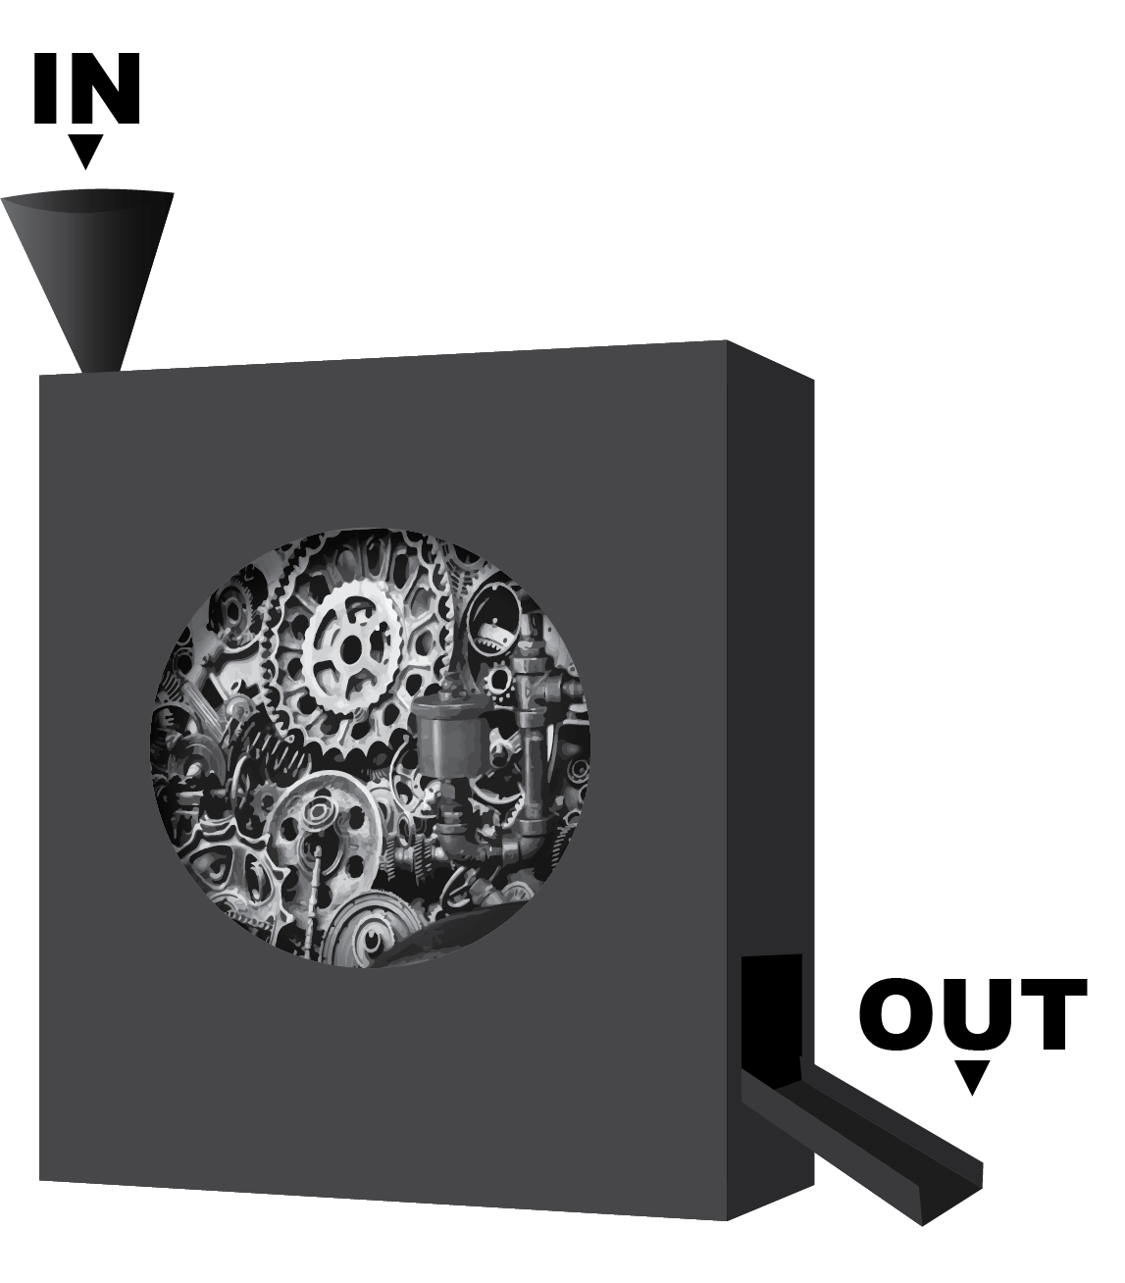
Introduction & Motivation
The Black Box Problem
Issues
Most ML models excel at predictions but fail at explanations
Complex models (neural networks, ensembles) lack transparency
Difficult to audit, debug, or build trust in decisions
Higher Impact in High Stakes Domains
Regulatory requirements increasingly demand explainability
Human decision-makers need to understand "why"
Black Box Model
Has complex mechanisms that are not hidden but not easily understand, and generally, higher predictive performance.
>
Pg: 15
Notes:
We're living in an age where machine learning models can achieve remarkable accuracy, but there's a fundamental problem: most of these models are black boxes. This is not to be taken literally because you can definitely examine the parameters of a neural network but they are far too complex to make sense. A neural network might correctly predict customer churn 95% of the time, but when asked why a particular customer is likely to leave, it can't give us a clear answer. This lack of transparency creates problems in high-stakes domains like healthcare, finance, and criminal justice, where understanding the reasoning is just as important as the prediction itself.

Slide 16
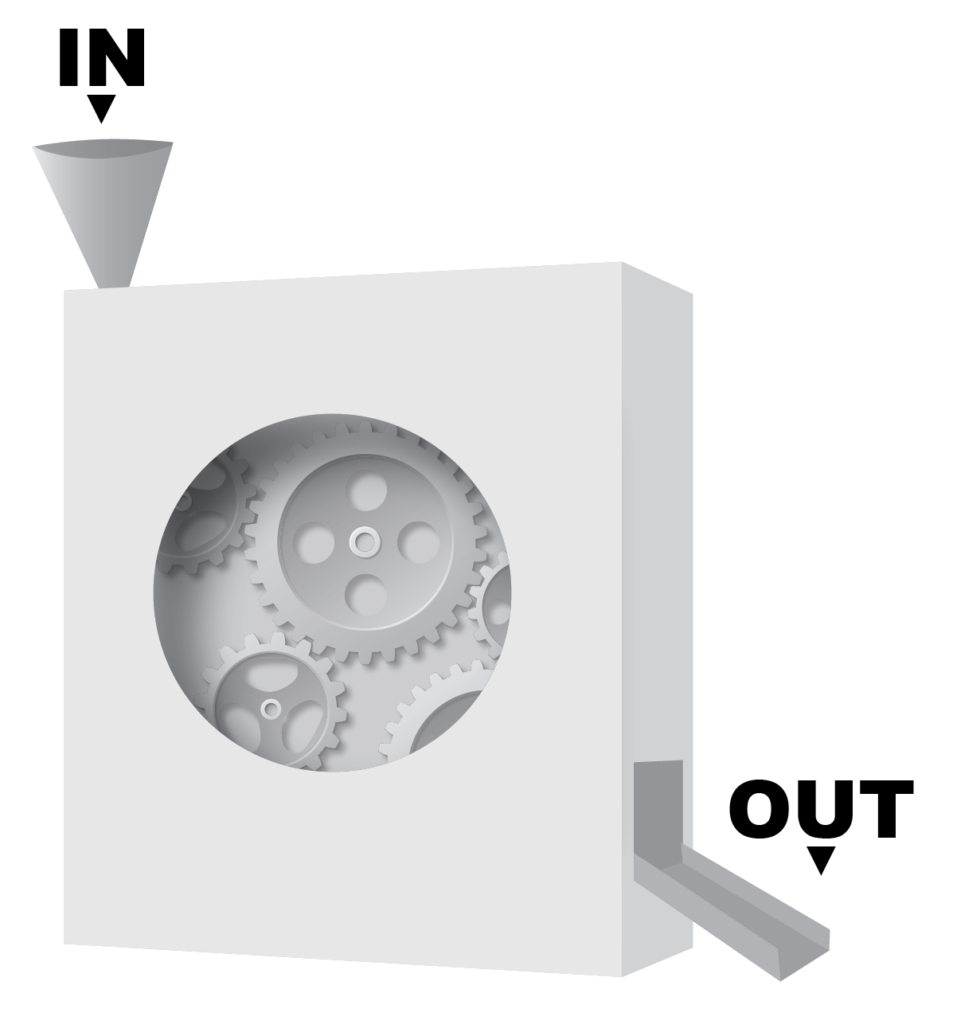
Introduction & Motivation
What Makes a Model Interpretable?
Transparency: Clear decision process visible to humans
Simplicity: Limited number of features and rules
Consistency: Similar inputs produce similar explanations
Actionability: Insights can guide real-world decisions
Auditability: Decisions can be traced and verified
✅
✅
✅
✅
✅
White Box Model
Has simple mechanisms, and generally more interpretable.
>
Pg: 16
Notes:
Before diving into specific models, let's establish what we mean by interpretability. A truly interpretable model should be transparent - you can see how it makes decisions. It should be simple enough for humans to understand, consistent in its reasoning, and provide actionable insights. Most importantly, it should be auditable - you should be able to trace back through the logic to understand exactly why a particular prediction was made.

Slide 17
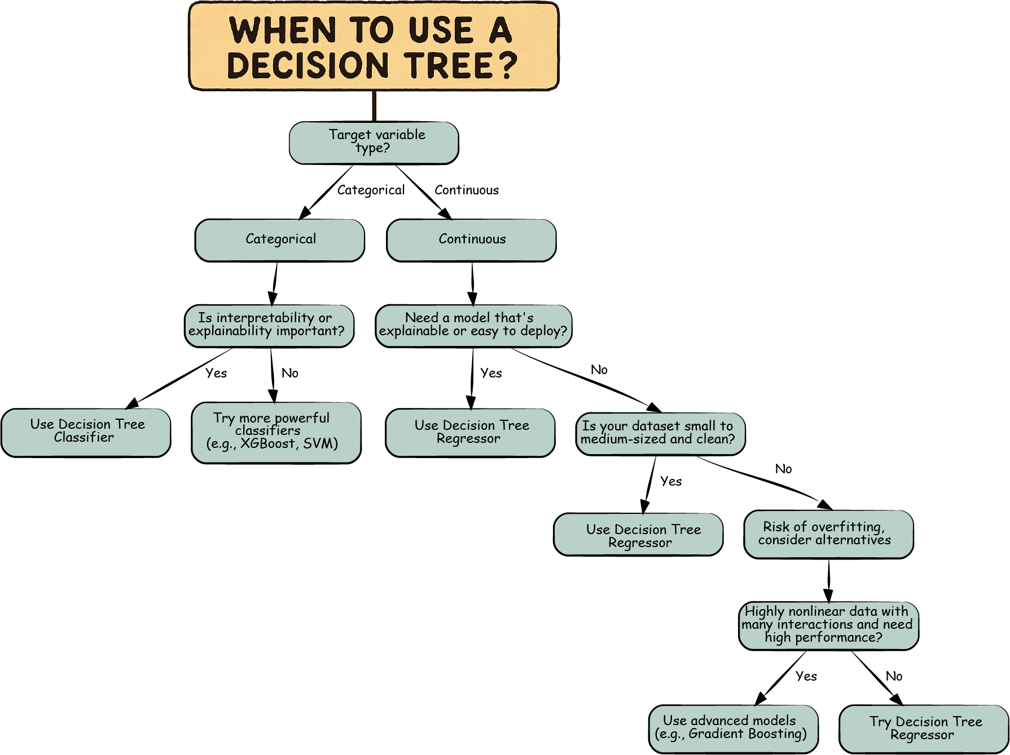
Introduction & Motivation
Rule-Based Models: The Natural Explainers
Explicit Decisions: through if-then logic
Transparent Thresholds: in processes like flowcharts
Visual & Intuitive: with human-readable rules and conditions. Natural structure for explanation & audit
White-box: Balance accuracy with interpretability
>
Pg: 17
Notes:
This is where rule-based models shine. They mirror the way humans naturally make decisions - through a series of if-then rules and conditions. When a doctor diagnoses a patient, they're essentially following a mental decision tree: if symptoms include fever and cough, then consider respiratory infection; if age is above 65, then increase concern level. Rule-based models formalize this intuitive process, creating transparent decision structures that humans can easily follow and understand. For instance, this decision tree of when to use a decision tree!

Slide 18
Section 02: Case Study with Trees

Slide 19
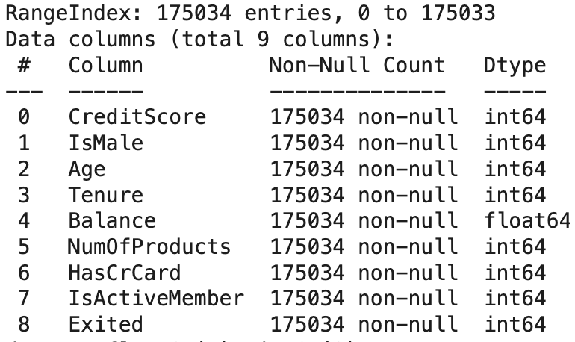
Case Study
Case Study: Predicting Bank Customer Churn
Dataset: Kaggle Competition Dataset (shubhammeshram579/bank-customer-churn-prediction)
Task: Predict customers that exited the bank (21.1% of cases)
Challenge: Despite Kaggle-esque inclination to focus on accuracy, interpretability is key to understanding churn in order to address the root causes.
Approach: Simple CART tree with depth of 3
>
Pg: 19
Notes:
Let's look at a concrete example using bank customer churn data. Our task is to predict which customers will leave the bank. This is a classic business problem that could help identify customers at risk of leaving. Although there’s a tendency to chase metrics to find the model with the highest predictive performance, we rather focus on interpretability to find root causes.

Slide 20
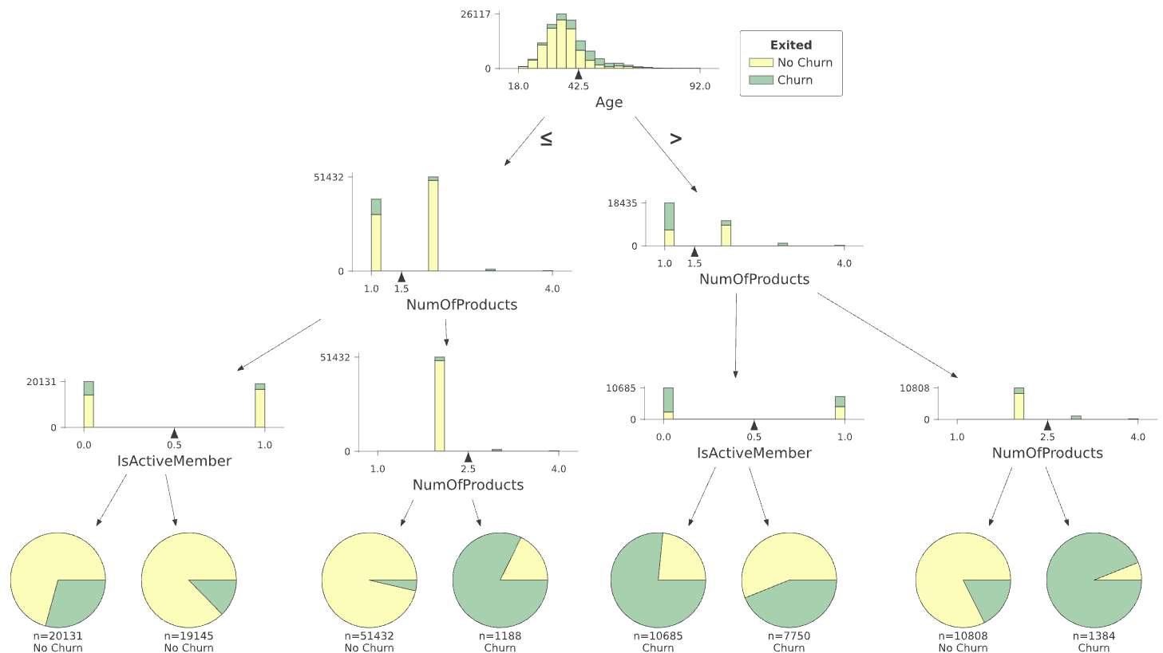
Case Study
Tree Structure Reveals Key Insights
Primary features: Age and # of Products
Secondary feature: Is Active Member
Logical thresholds: Clear decision boundaries at 42 years and 1 product
Dominant patterns: Just a few features drive most decisions
Interpretable splits: Each condition makes business sense
>
Pg: 20

Slide 21
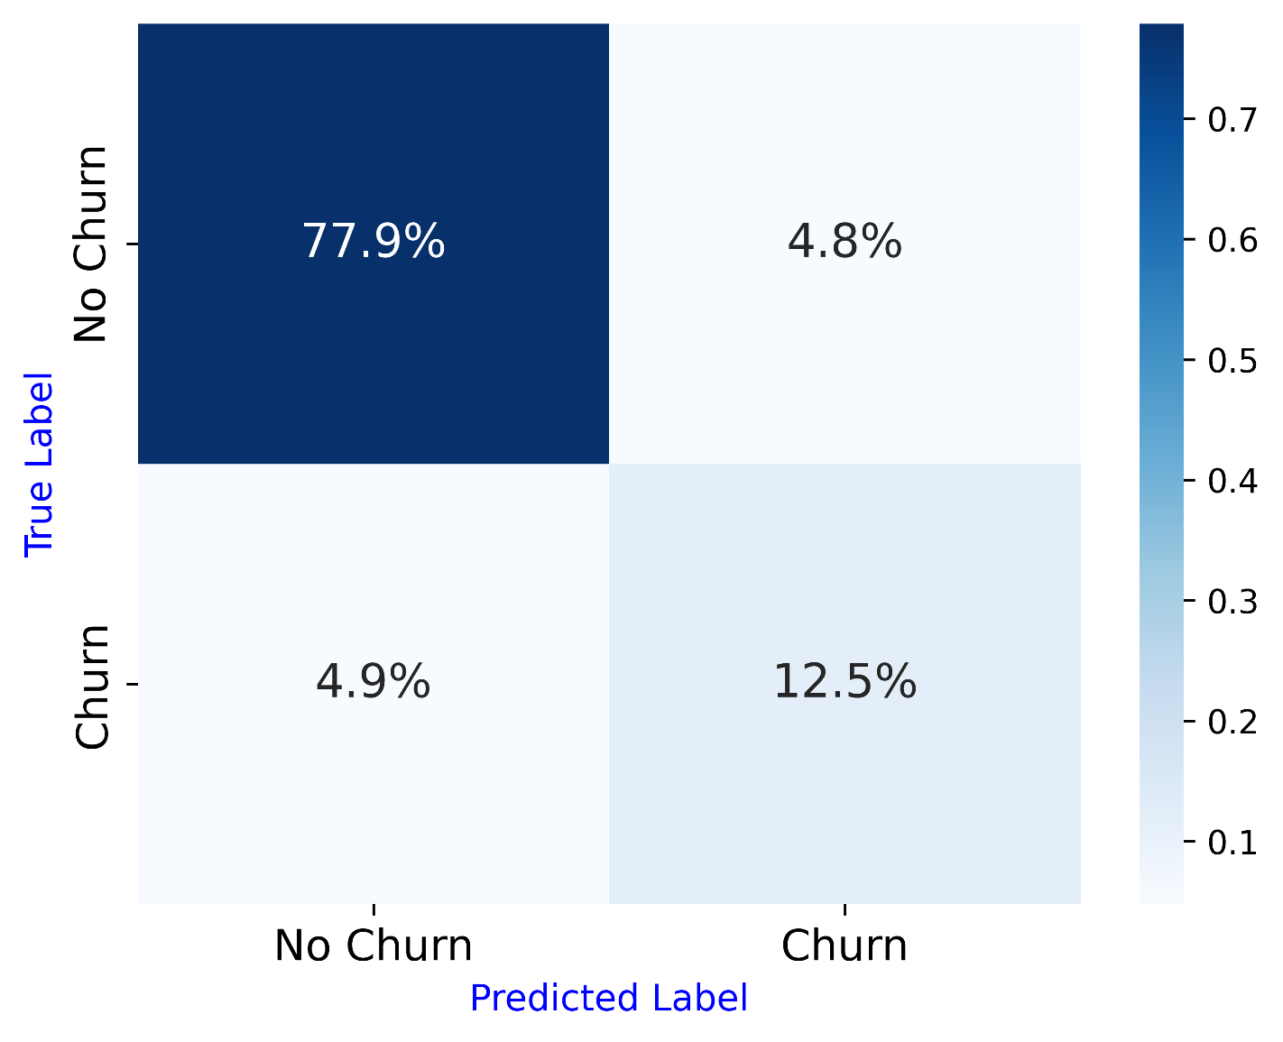
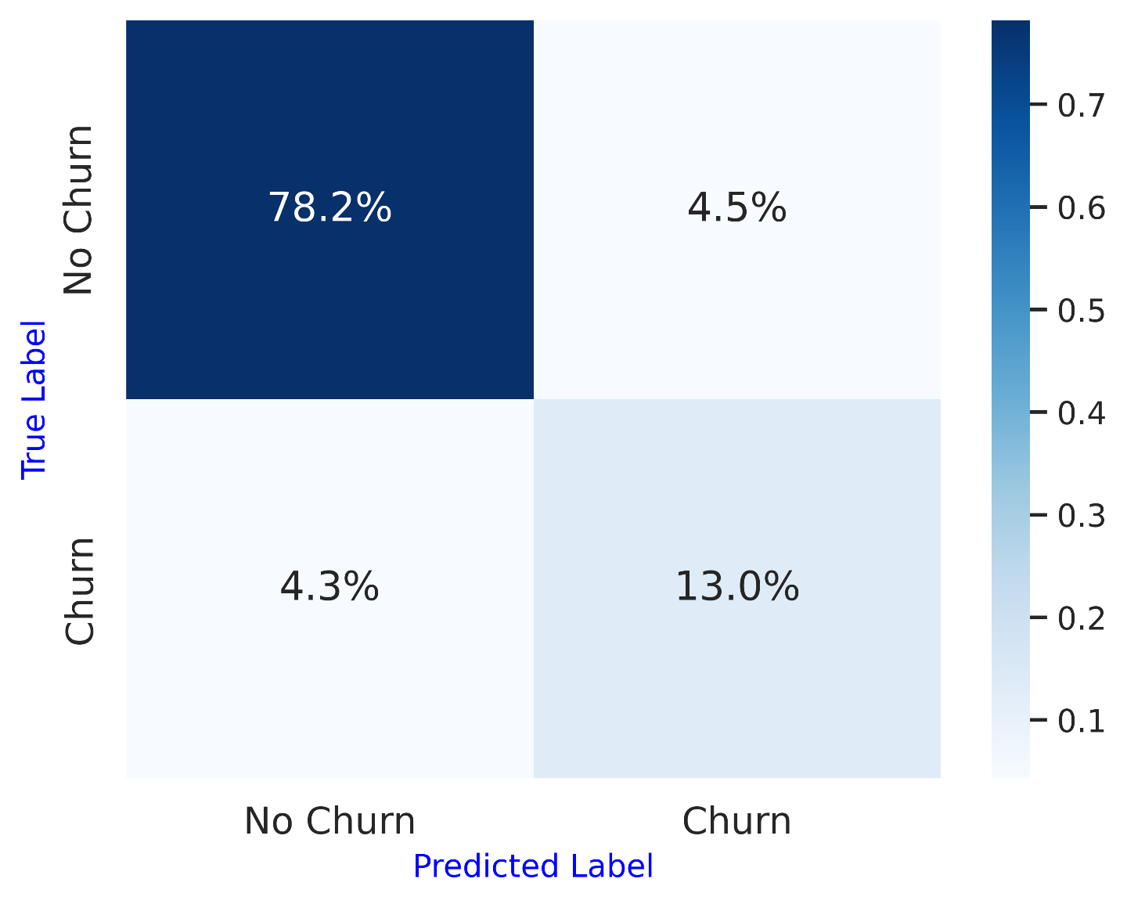
Case Study
Decision Tree is only 0.8% less accurate than XGBoost
Is it worth driving decisions with XGBoost or a similar model based on that small difference?
Decision Tree Test: 90.4% Train: 89.3%
XGBoost Test: 91.2% Train: 93.9%
>
Pg: 21

Slide 22
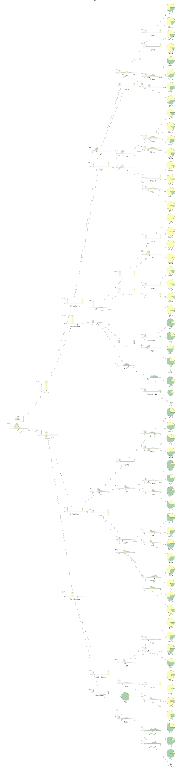
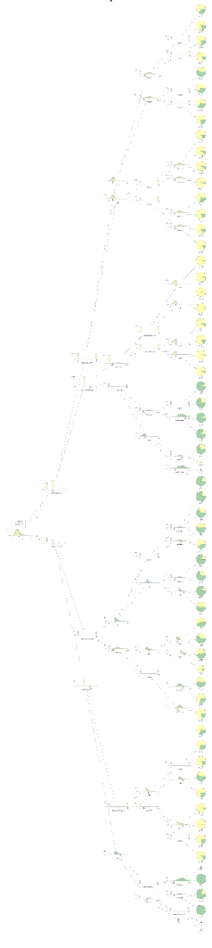
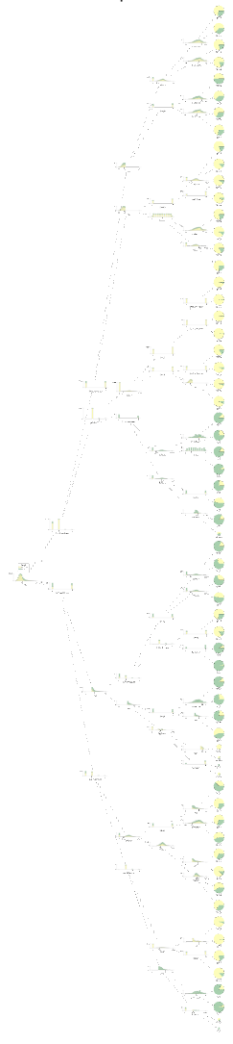
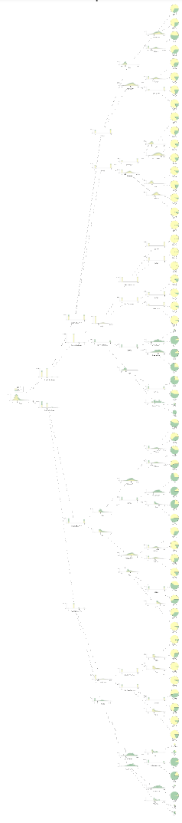
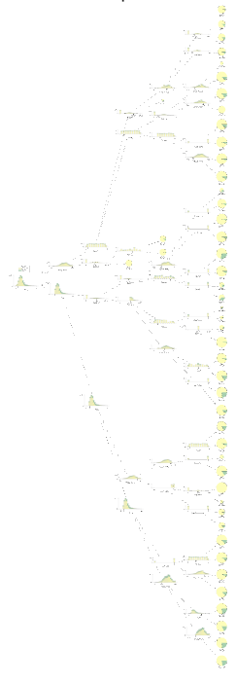
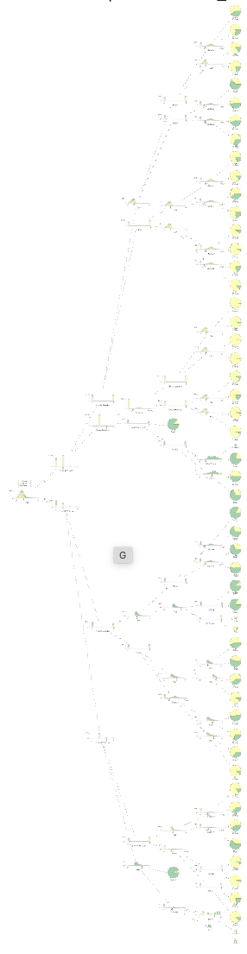
Case Study
Our XGBoost Model has 100 trees!
…
1
2
3
4
5
100
>
Pg: 22

Slide 23
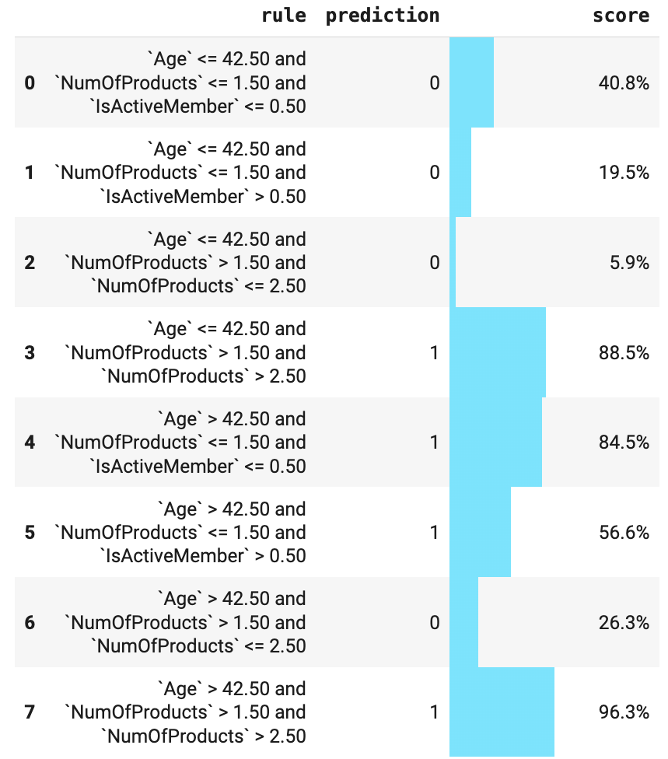
Case Study
From Trees to Rules
Rule Extraction Process:
Walk each path from root to leaf
Collect conditions along the way
Combine into readable if-then statements
Calculate scores for each rule
>
Pg: 23
Notes:
One of the most powerful aspects of decision trees is that we can easily extract explicit rules. For each path through the tree, we collect all the conditions and combine them into readable if-then statements. For example: "If Age> 42 AND Number of Products ==1 and IsActiveMember == False, then predict churn with a score of 84.5.” These rules can be stored, shared, and even used independently of the original tree structure.

Slide 24
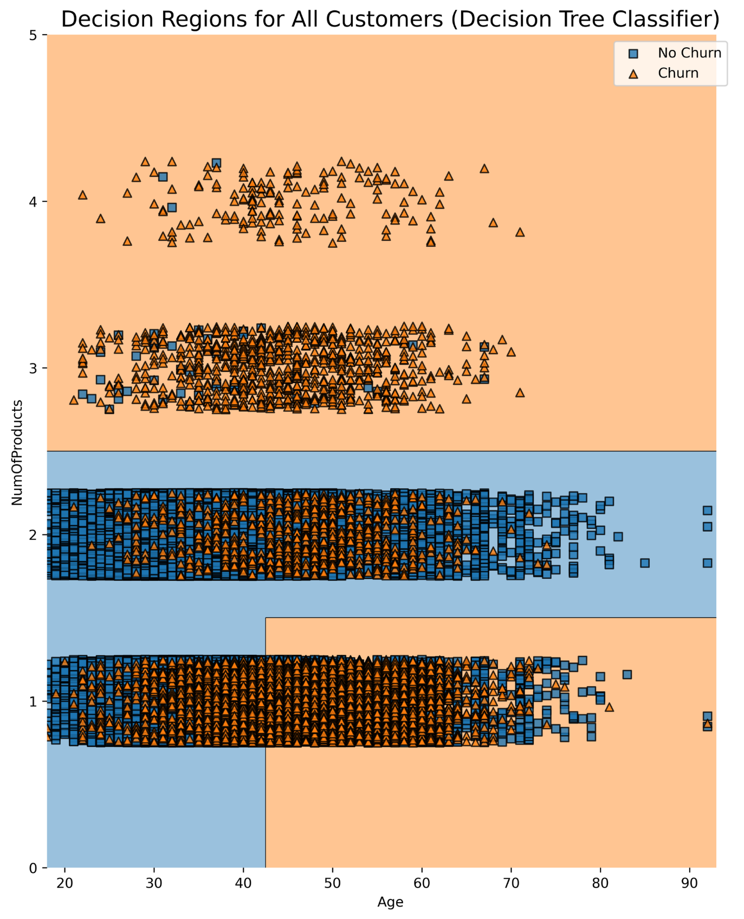
Case Study
Decision Boundaries
Decision regions: How the model carves up feature space
Clear boundaries: Sharp transitions between classes
Geometric interpretation: Rectangular regions in 2D space
Alignment check: Do boundaries match data patterns?
>
Pg: 24
Notes:
Decision trees create very distinctive decision boundaries - they carve up the feature space into rectangular regions. Each region corresponds to a leaf node in the tree. This geometric interpretation helps us understand not just what the model predicts, but how it partitions the problem space. We can visually inspect whether these boundaries make sense given the actual data distribution, which is much harder to do with more complex models.

Slide 25
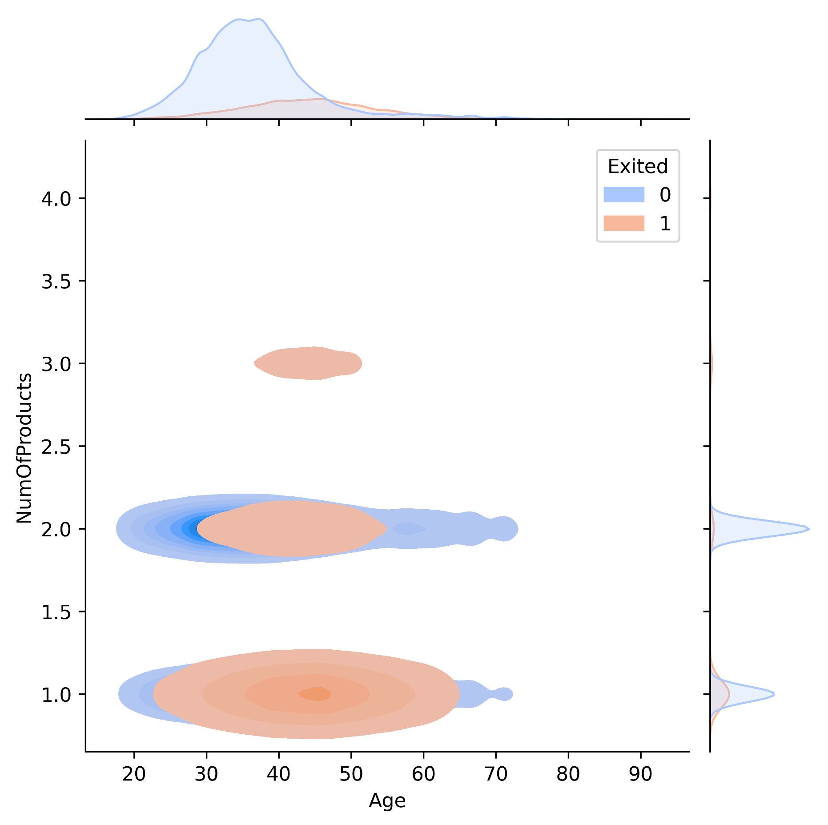
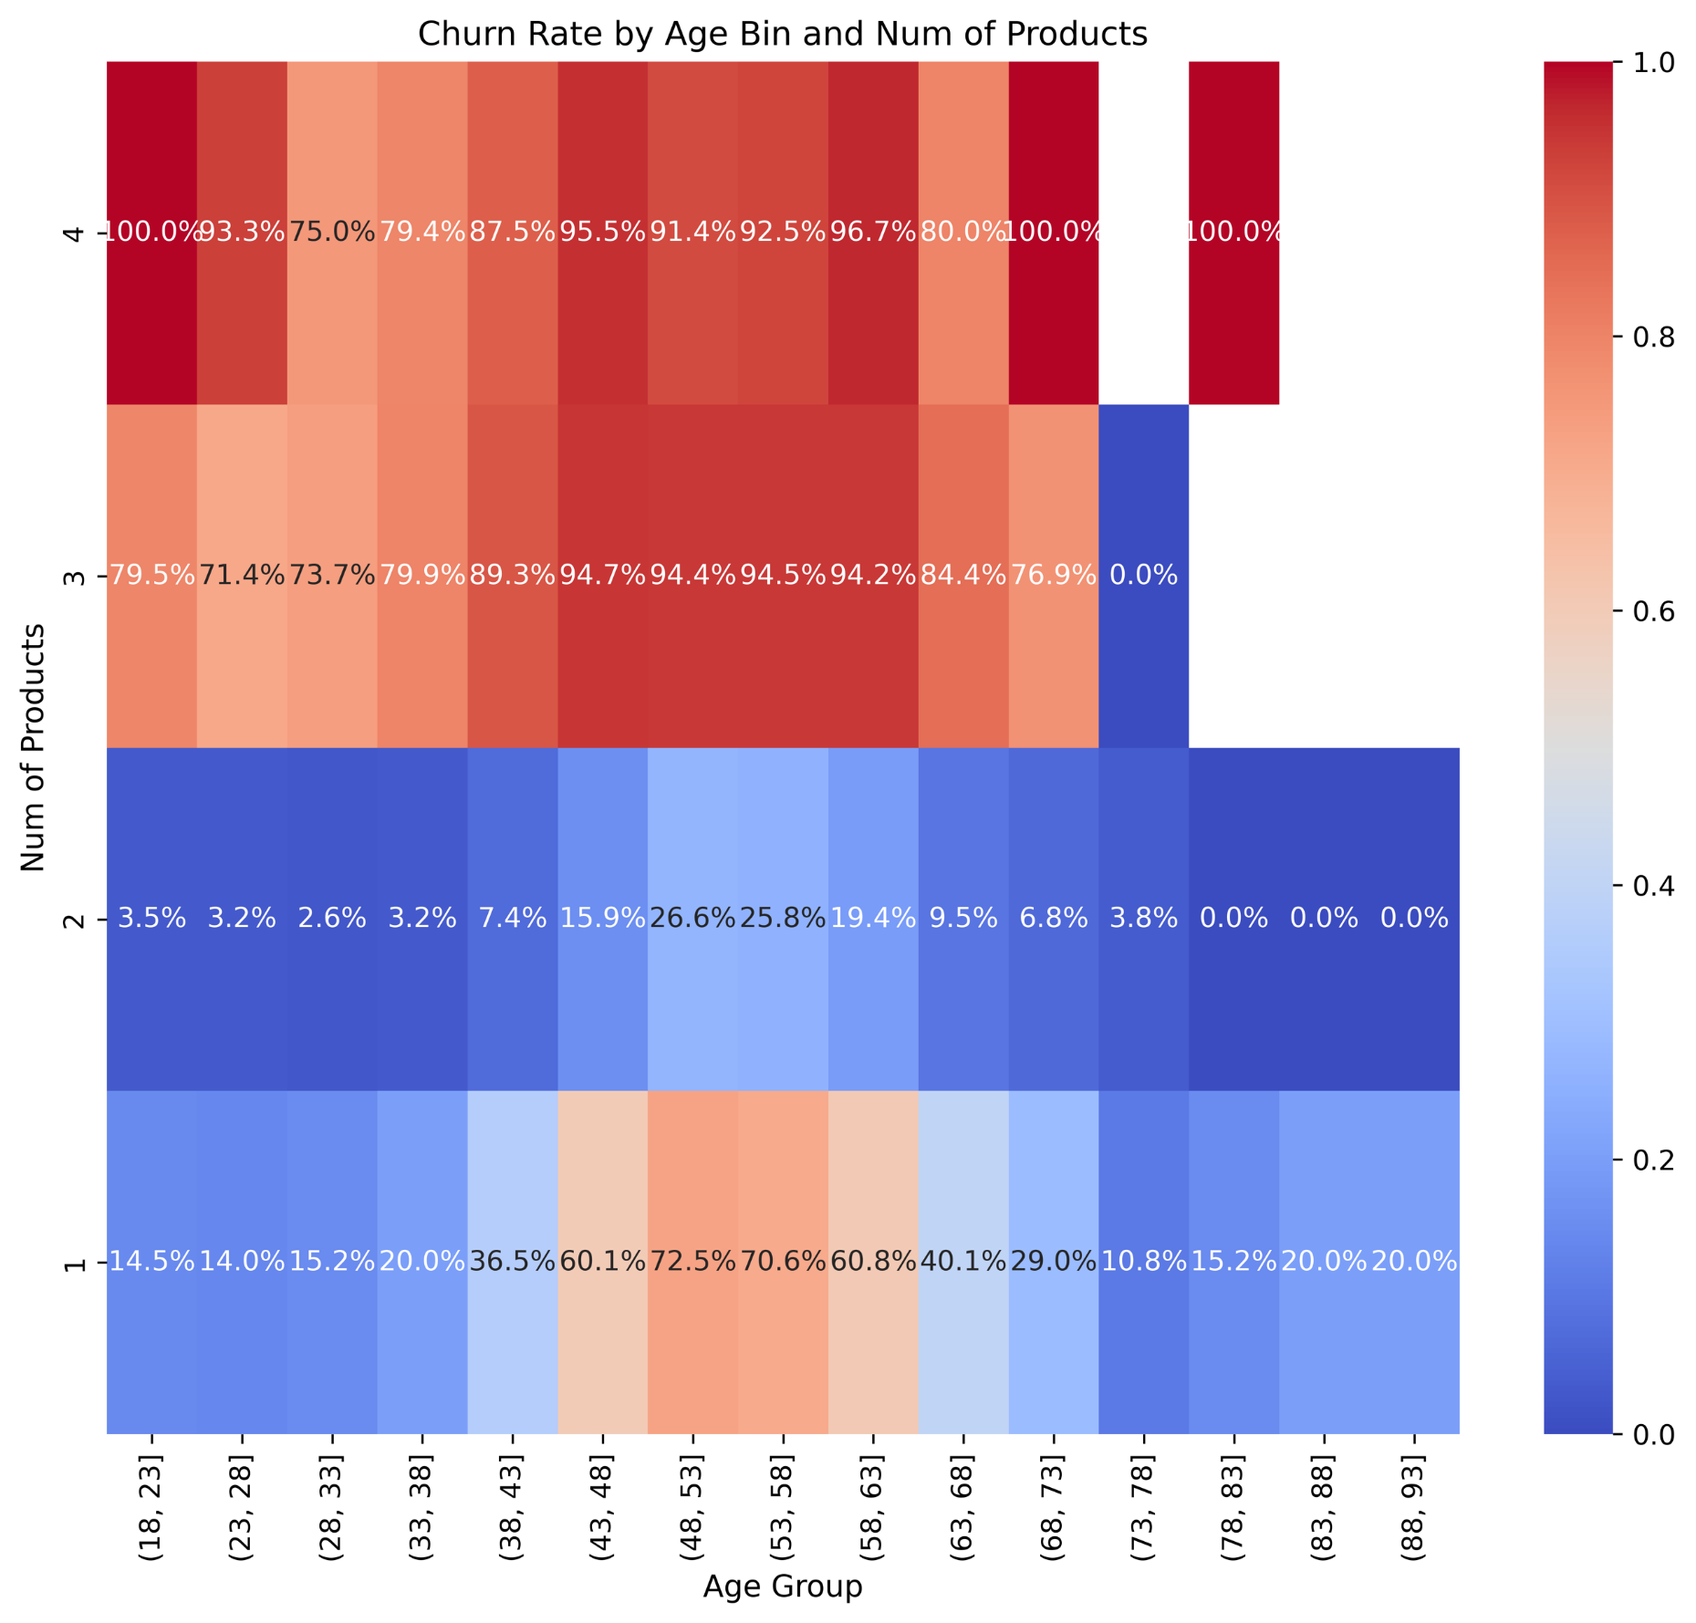
Case Study
Bivariate Distributions Against Target Variable
Decision regions: How the model carves up feature space
Clear boundaries: Sharp transitions between classes
Geometric interpretation: Rectangular regions in 2D space
Alignment check: Do boundaries match data patterns?
>
Pg: 25

Slide 26
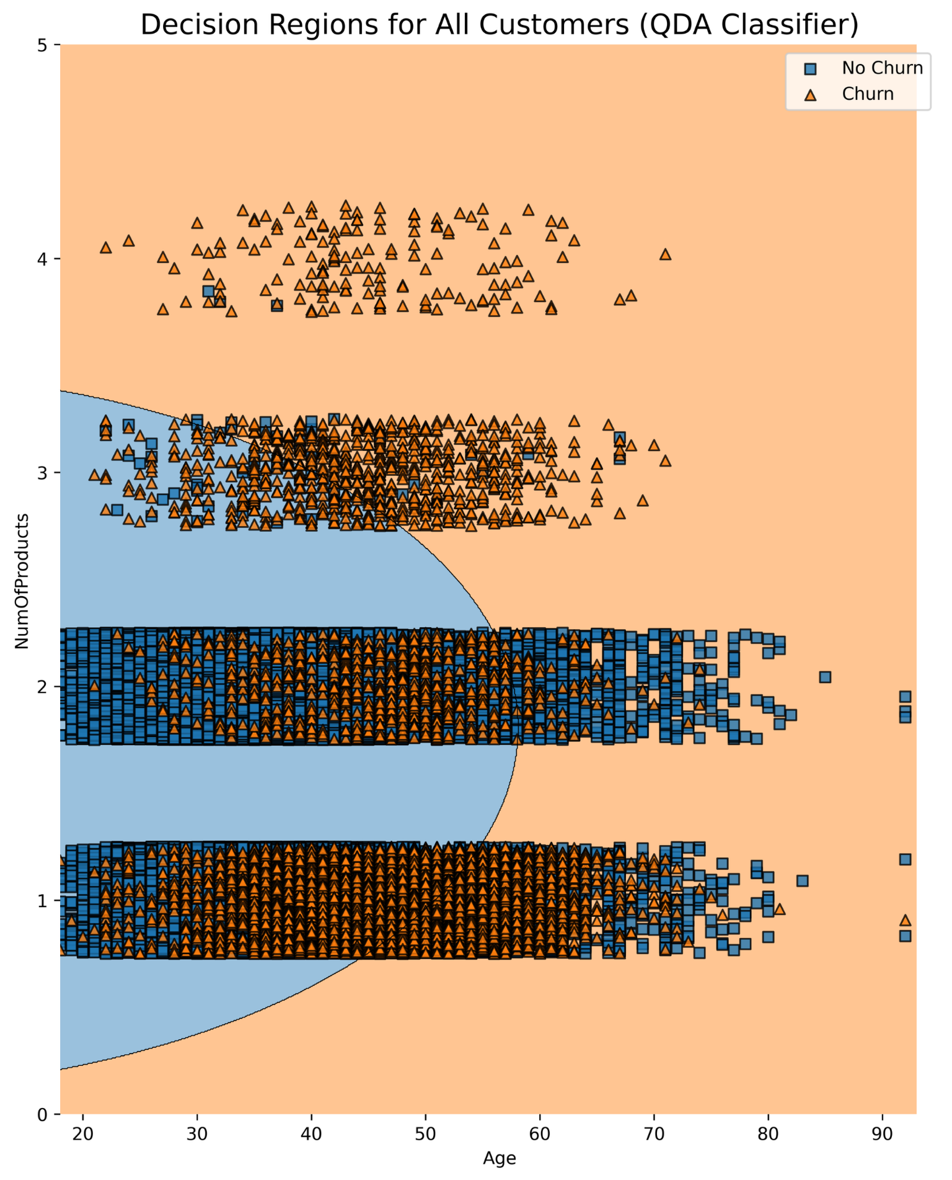
Case Study
Limitations of Standard Trees
Optimization for accuracy, not interpretability
Potential for complex rules with redundant conditions
Overfitting can create overly specific paths
Instability - small data changes can drastically alter structure
Limited expressiveness - only axis-aligned splits
>
Pg: 26
Notes:
While decision trees are naturally interpretable, they're not perfect. Standard algorithms like CART optimize for predictive accuracy, not interpretability. This can lead to unnecessarily complex trees with redundant conditions. Trees are also notoriously unstable - small changes in the training data can result in completely different tree structures. And they're limited to axis-aligned splits, which means they can't capture diagonal boundaries that might be more natural for certain problems. However, other kinds of decision boundaries like this curved one for the Quadratic Discriminant Analysis model are impossible to describe in a human-friendly way.

Slide 27
Section 03: Beyond Trees

Slide 28
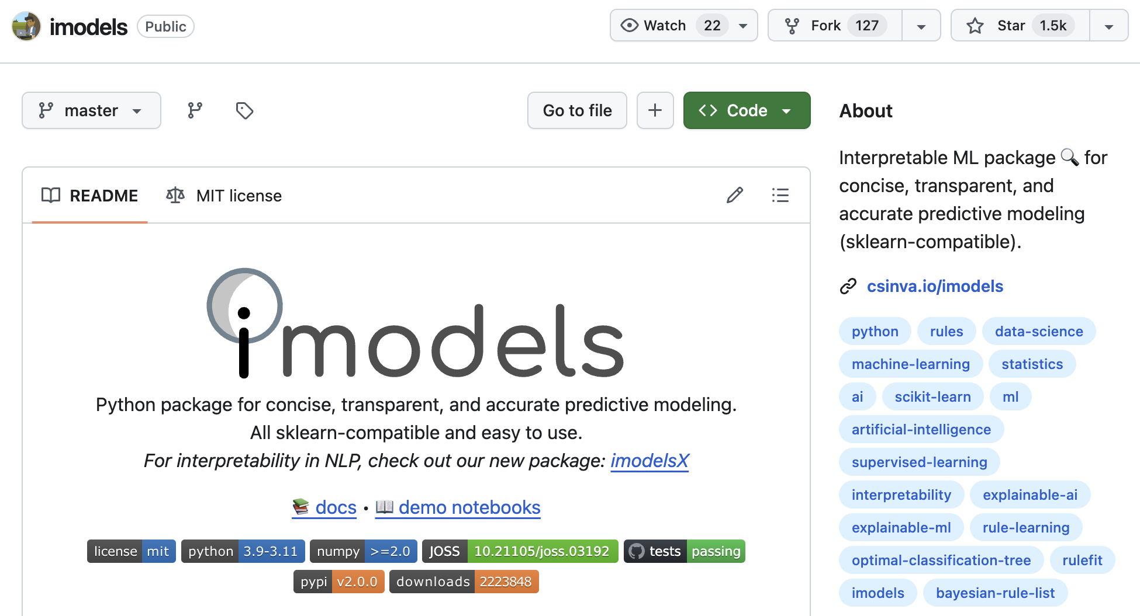
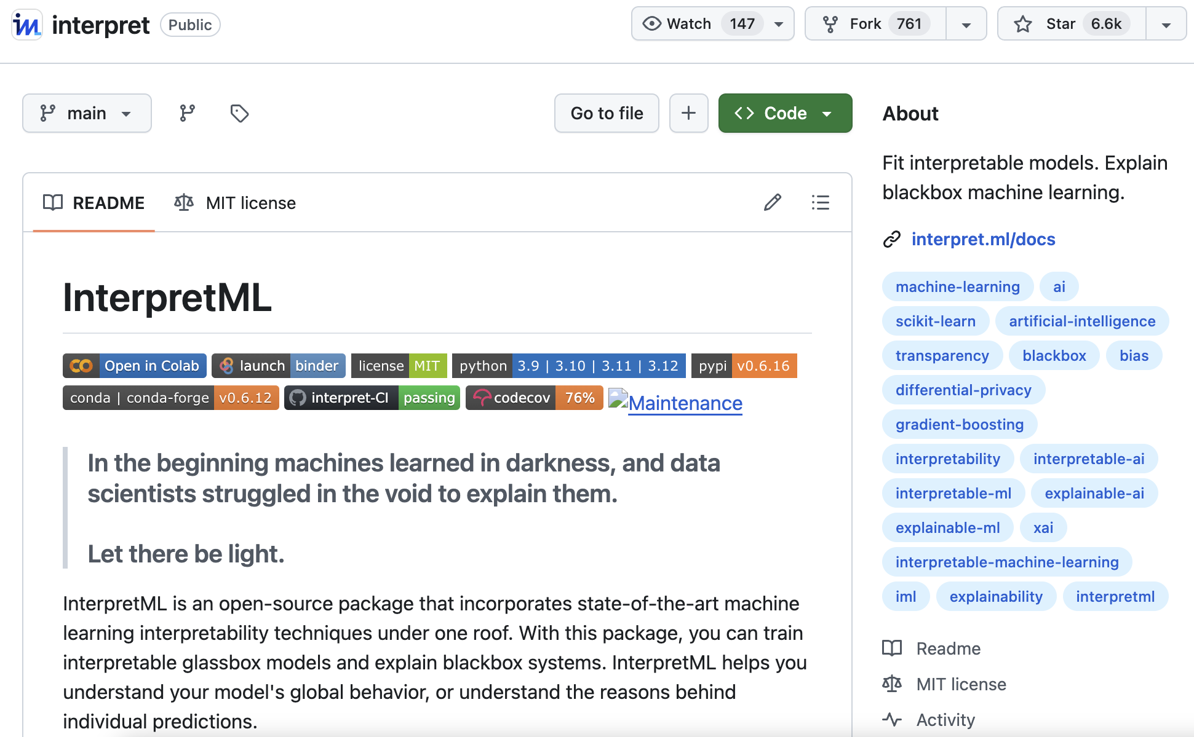
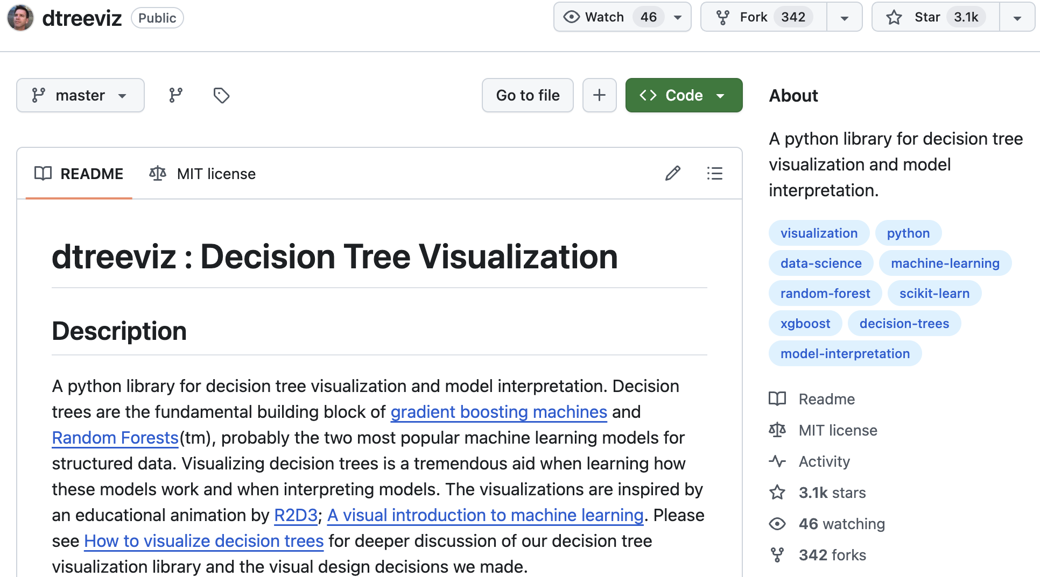
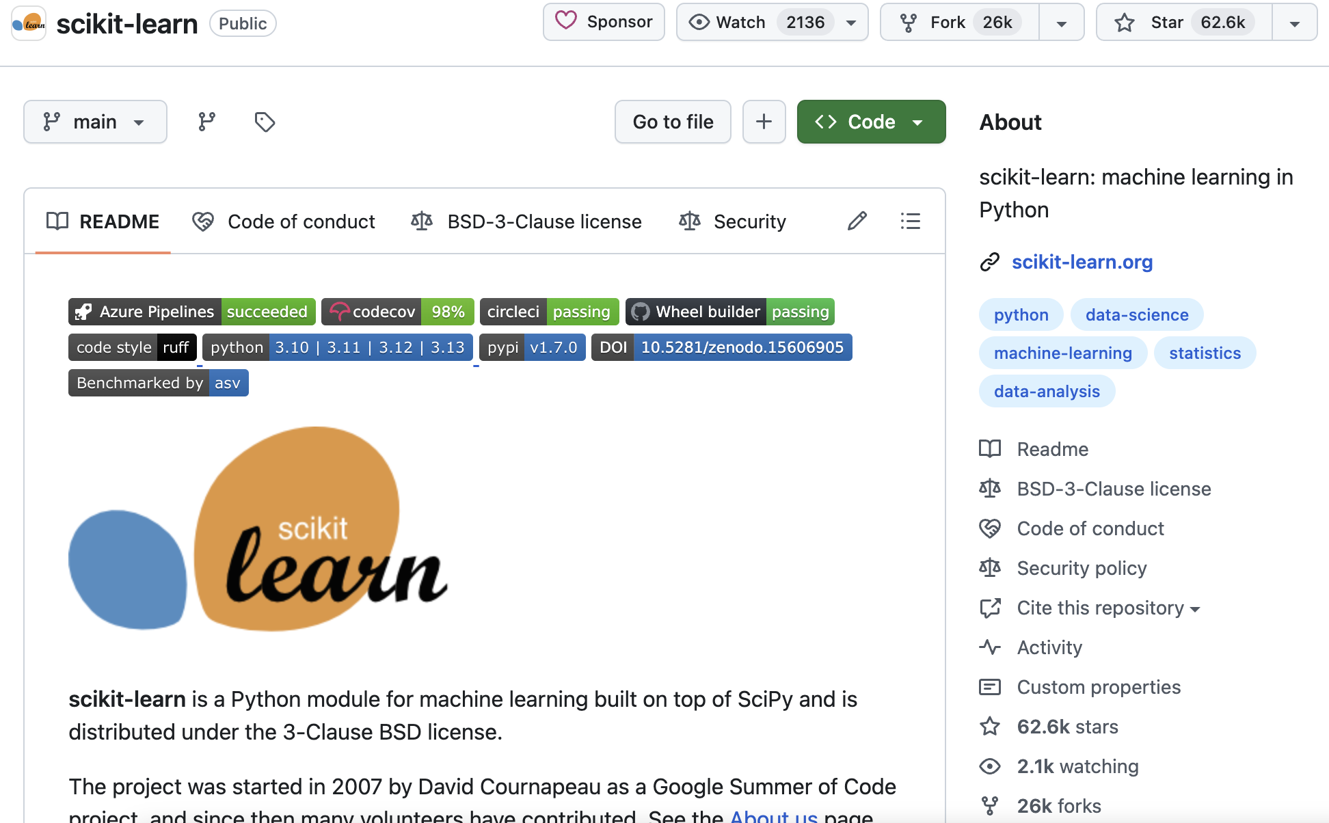
Beyond Trees
Python Packages for Rule-Based Modeling
>
Pg: 28

Slide 29
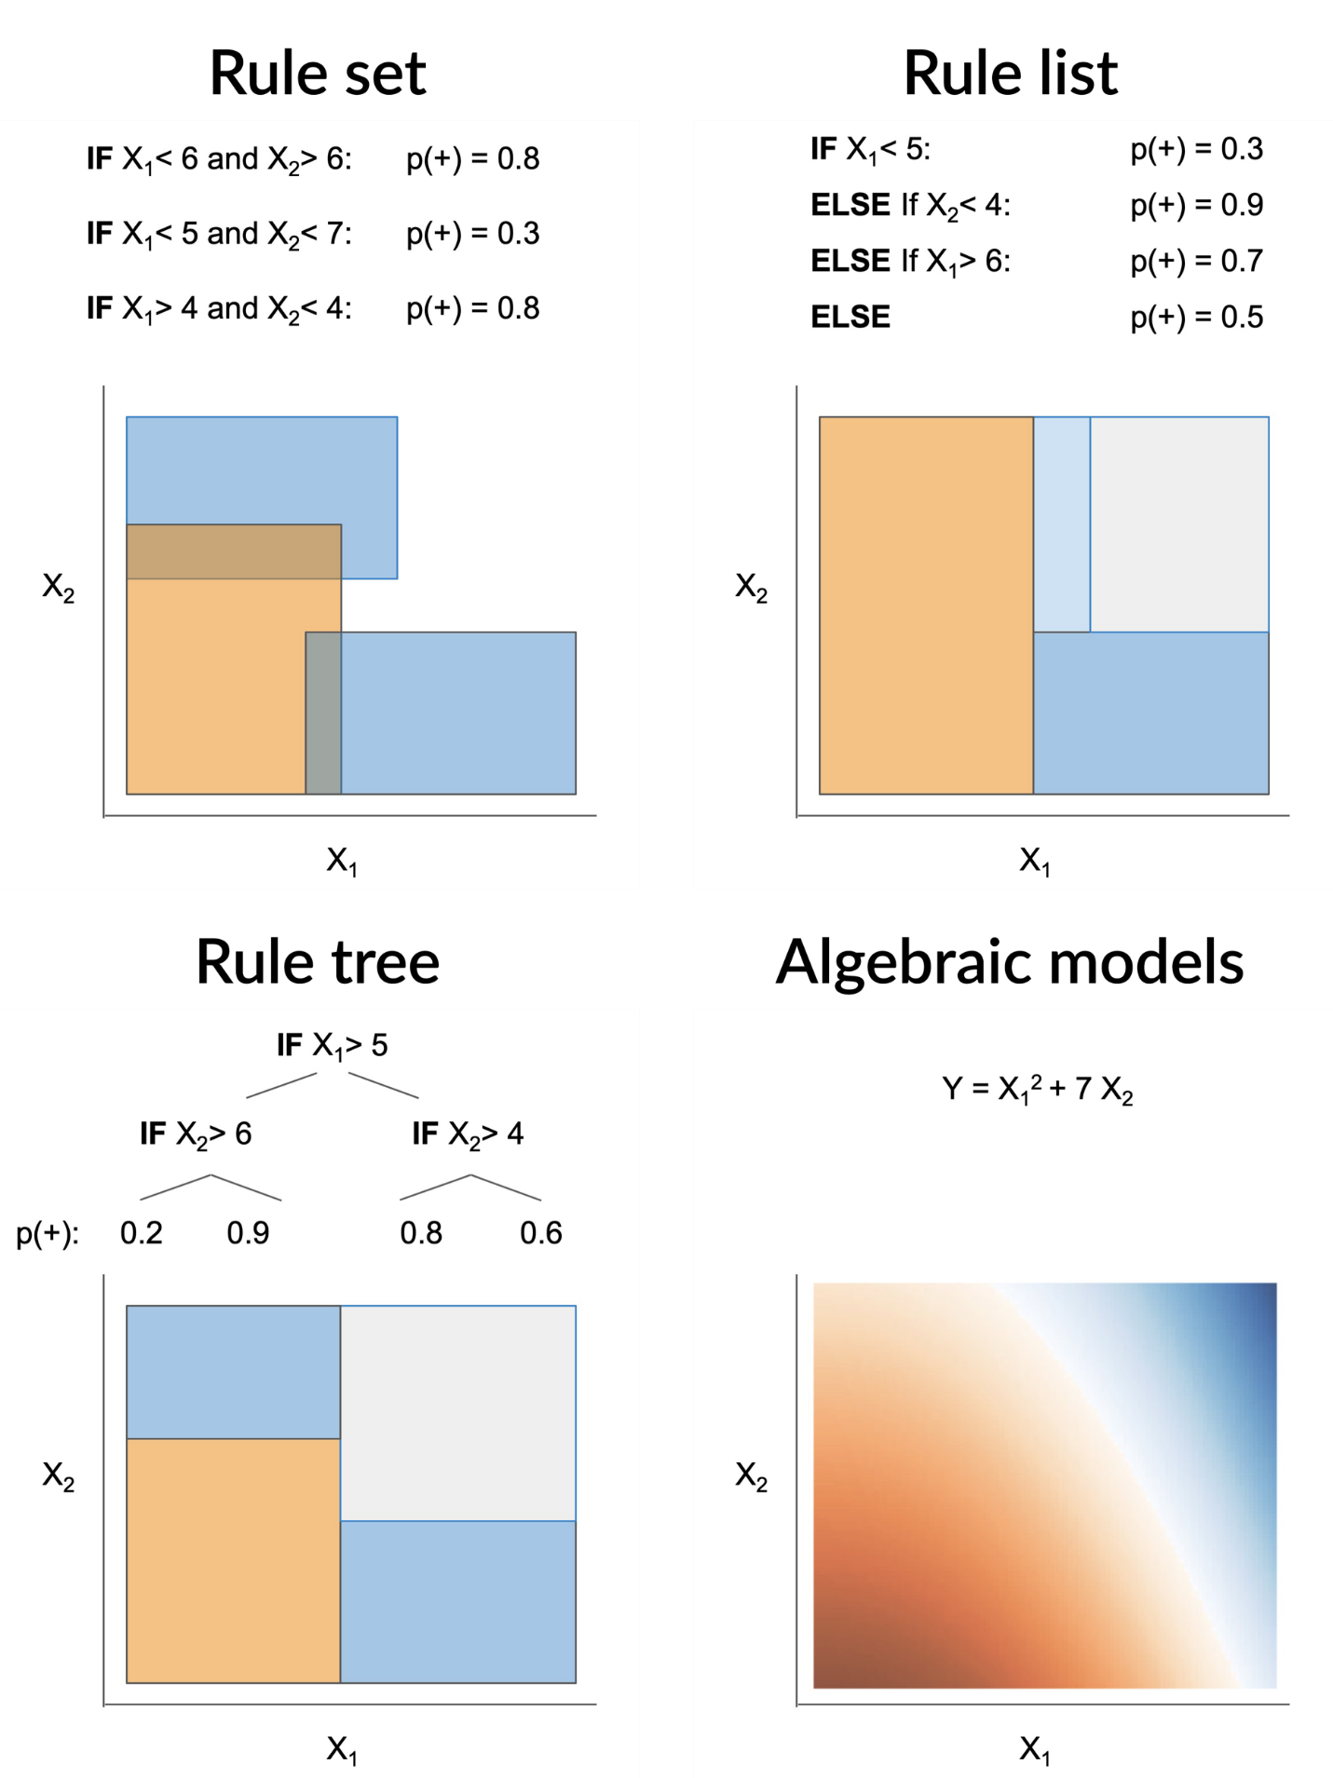
Beyond Trees
Rule-Based Model Family: The Natural Explainers
Rule Sets: Unordered collections of weighted rules.
Rule Lists: Ordered decision lists with precedence.
Rule Trees: Interpretability-optimized tree algorithms.
Hybrid Models: Combining multiple approaches including…
Algebraic Models: Leverages linear or symbolic regression components.
>
Pg: 29
Notes:
Decision trees are just one member of a broader family of rule-based models. Each approach has different strengths and trade-offs. Rule sets treat all rules equally and combine their predictions. Rule lists enforce an order where earlier rules take precedence. Rule trees use different algorithms specifically designed for interpretability. And hybrid models combine the best of multiple approaches.

Slide 30
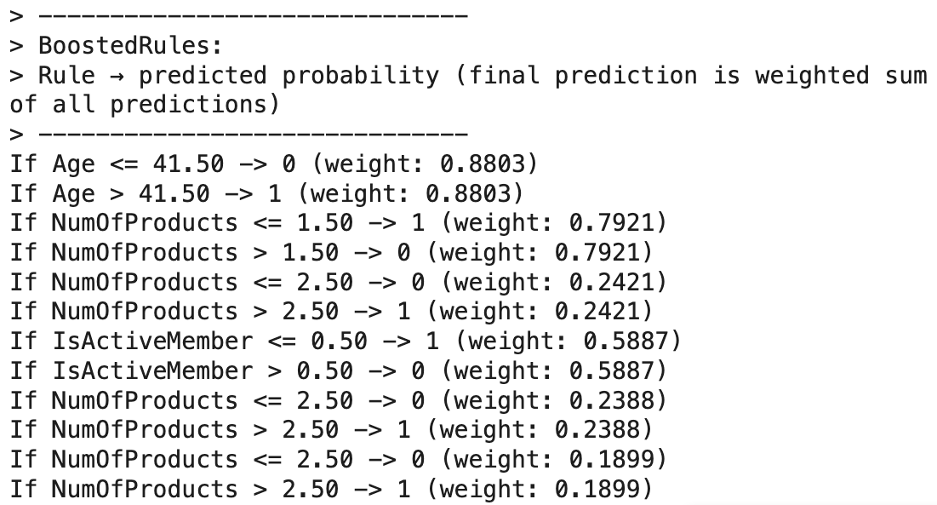
Beyond Trees
Rule Sets - Democratic Decision Making
Unordered collections of individual rules
Weighted voting system for final predictions
Partial predictions from each rule
Example: BoostedRulesClassifier combines probability weights
>
Pg: 30
Notes:
Rule sets take a democratic approach to decision making. Instead of following a single path like in a decision tree, rule sets evaluate all applicable rules and combine their predictions. Each rule contributes a weighted vote to the final decision. This can capture more nuanced patterns than a single tree path, but it also makes the decision process more complex to explain since you need to consider multiple rules simultaneously.

Slide 31
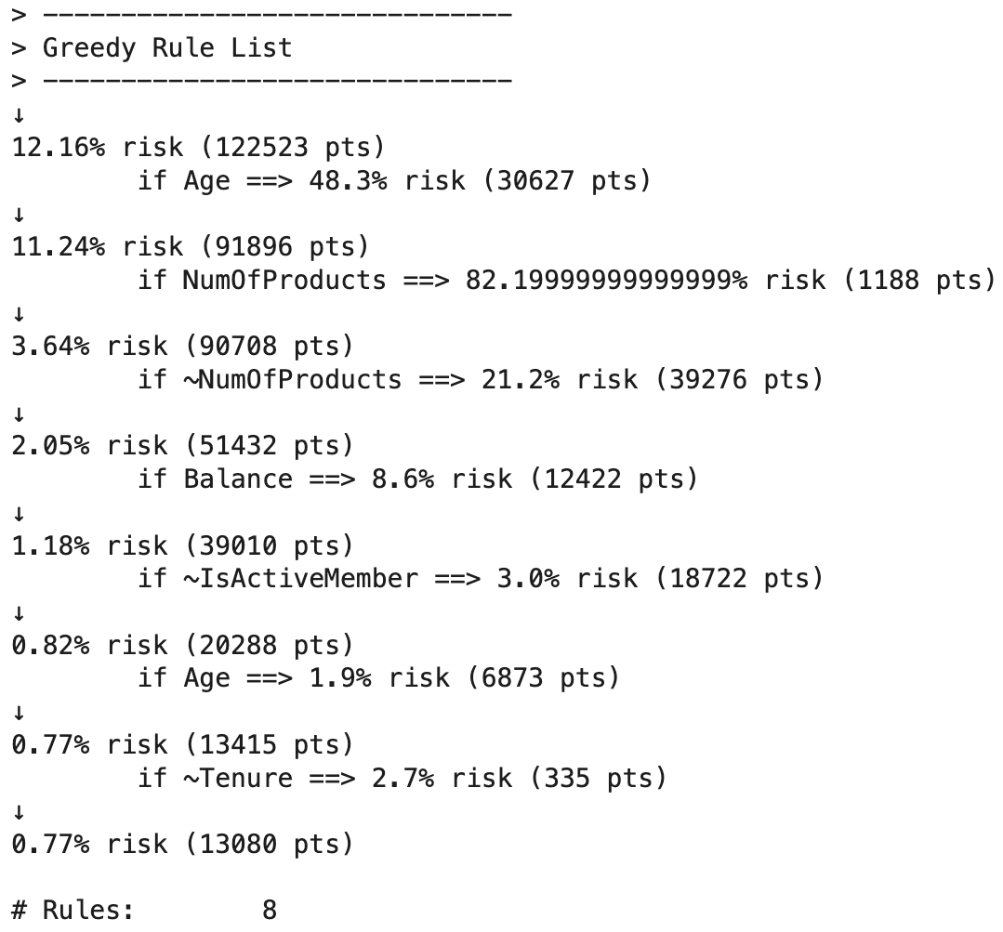
Beyond Trees
Rule Lists - Sequential Logic
Ordered decision lists: "If this, then that, else..."
No overlapping rules - first match wins
Examples: OneR, GreedyRuleList
Simplicity: Often use only 1-2 features
Trade-off: May underfit complex patterns
>
Pg: 31
Notes:
Rule lists enforce a strict order where the first matching rule determines the prediction. This is like a series of if-else statements in programming. The advantage is crystal-clear logic - you know exactly which rule fired for any given prediction. However, this constraint can be limiting. In practice, rule lists often end up using only one or two features, which may not capture the full complexity of the problem.

Slide 32
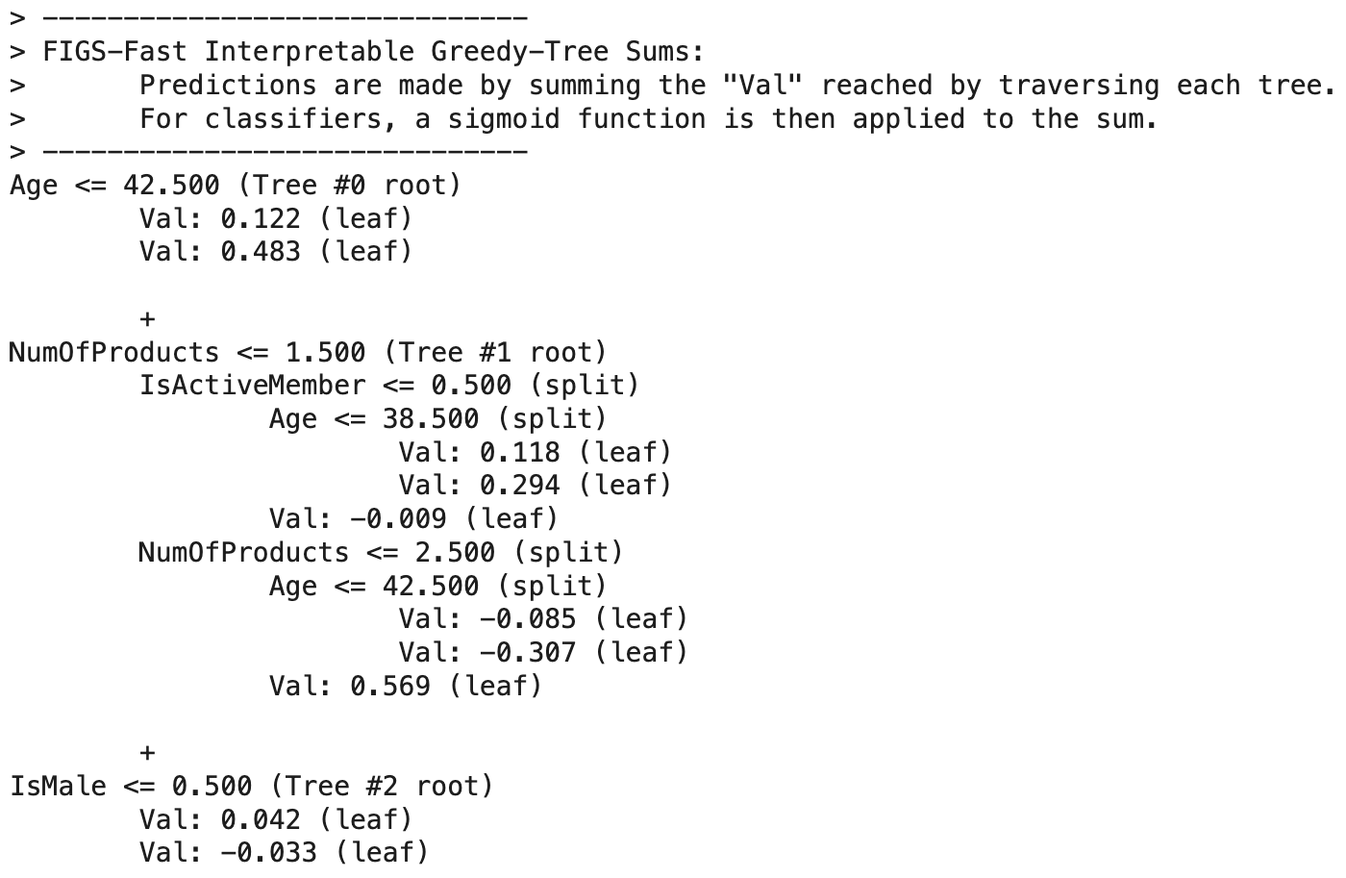
Beyond Trees
Rule Trees - Interpretability First
FIGS (Fast Interpretable Greedy-tree Sums)
Multiple additive trees contributing to final prediction
Avoids redundant splits for cleaner structure
Smoother boundaries than standard trees
Optimized for human understanding
>
Pg: 32
Notes:
Rule trees like FIGS represent a new generation of algorithms designed specifically for interpretability. Unlike standard CART trees that optimize purely for accuracy, FIGS explicitly avoids redundant splits and creates cleaner, more understandable structures. It builds multiple small trees that work together additively, resulting in smoother decision boundaries that are often more intuitive than the hard rectangular boundaries of single trees.

Slide 33
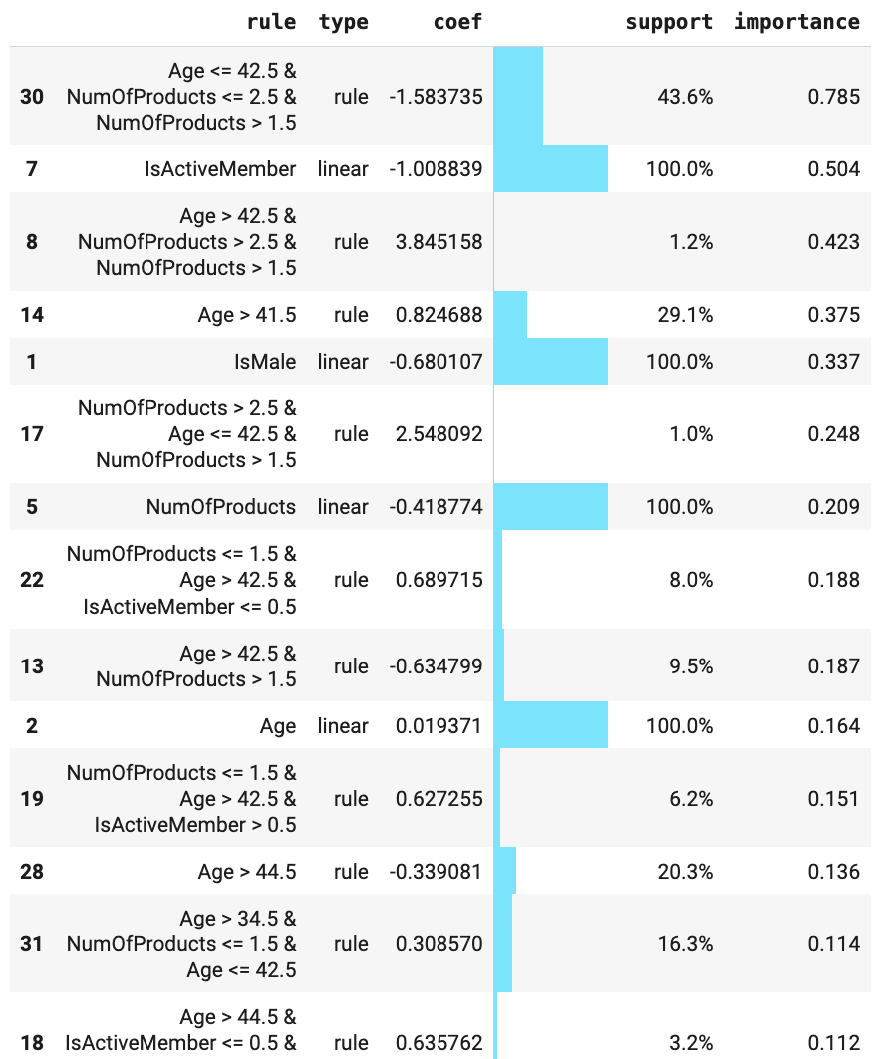
Beyond Trees
RuleFit - The Hybrid Champion
Two-stage process: Extract rules, then fit linear model
Combines rules with original features
Sparse linear model (L1-penalized logistic regression)
Best of both worlds: Nonlinear interactions + linear interpretability
Smooth diagonal boundaries unlike hard tree splits
>
Pg: 33
Notes:
RuleFit represents perhaps the most sophisticated approach to interpretable modeling. It's a two-stage process: first, it extracts rules from a tree ensemble, then it treats these rules as binary features and fits a sparse linear model. This means RuleFit can capture complex nonlinear interactions through the rules while maintaining the interpretability of linear models. The result is smoother, more realistic decision boundaries that often generalize better than pure tree approaches.

Slide 34
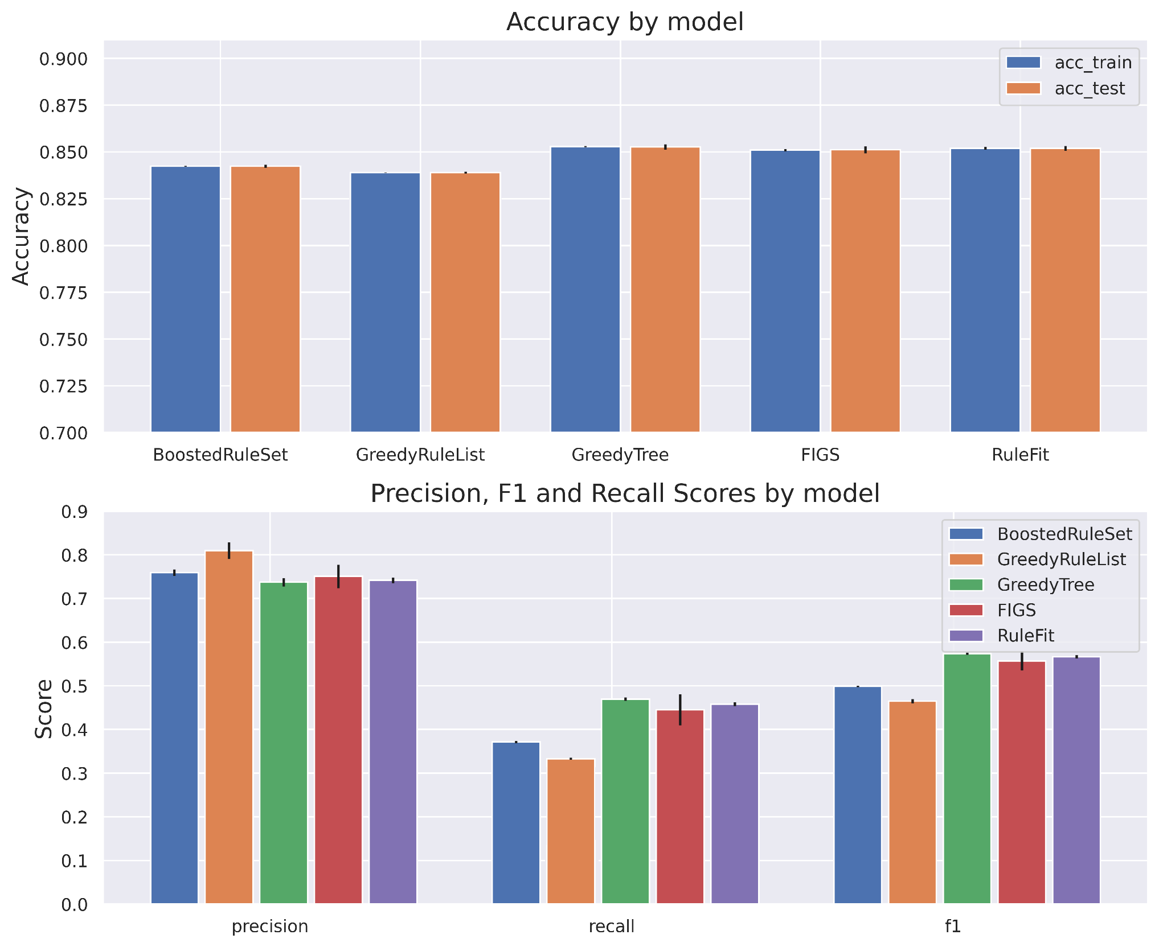
Beyond Trees
Performance Comparison
Accuracy: Most models perform similarly
Precision vs Recall: Some differences emerge
GreedyRuleList: Top performer for precision
RuleFit: Most consistent across cross-validation Folds
Trade-offs: Complexity vs. performance vs. interpretability
>
Pg: 34
Notes:
When we evaluate these models on real data, interesting patterns emerge. While most achieve similar accuracy, they differ dramatically in precision and recall. RuleFit consistently shows the best precision, making it valuable when false positives are costly. However, the best model depends on your specific needs - sometimes a simple rule list is preferable even if it's slightly less accurate, because it's much easier to understand and implement.

Slide 35
Section 04: Practical Considerations

Slide 36
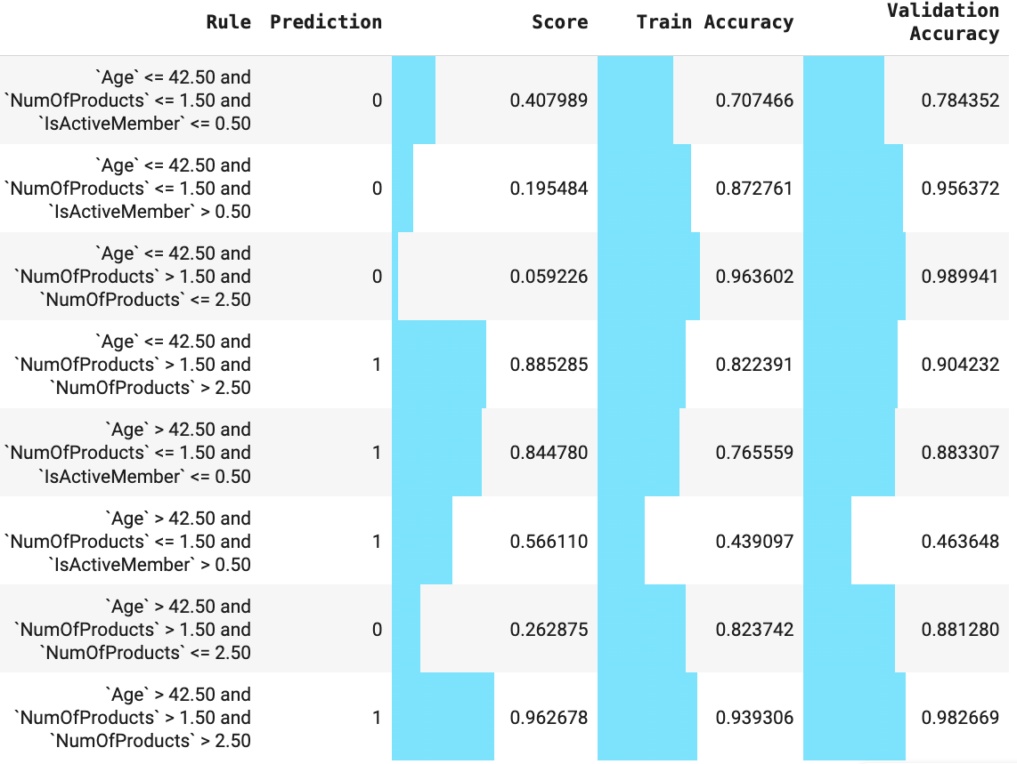
Practical Considerations
Beyond Model-Level Evaluation
Individual rule performance matters as much as overall model
Rule-level performance on train and test data
Generalization concerns: Training vs. test performance gaps
Coverage analysis: How many samples each rule affects
>
Pg: 36
Notes:
One of the most important insights from interpretable modeling is that evaluation shouldn't stop at the model level. Individual rules can have very different performance characteristics. A rule that looks great on training data might completely fail to generalize. We need to evaluate each rule separately on test data, looking at both its precision and recall, as well as how many samples it covers. This granular analysis is crucial for building trust in interpretable models.

Slide 37
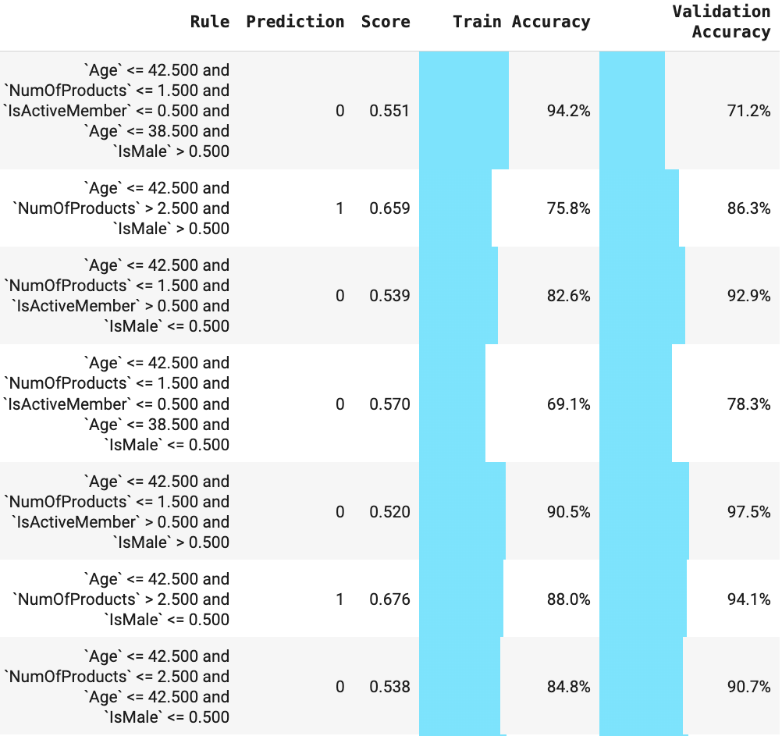
Practical Considerations
The Generalization Reality Check
Rule A: 94% precision (train) → 71% precision (val)
Rule B: 76% precision (train) → 86% precision (val)
Lesson: Broader coverage often means better generalization
>
Pg: 37
Notes:
Here's a sobering reality check from our churn example. For the FIGS model, one rule showed over 94% precision on training data but achieved just over 70% precision on test data - a complete failure to generalize. Another rule with lower training precision maintained its performance on test data. The difference? The second rule covered more samples and represented a more general pattern. This highlights why we need to be skeptical of rules that seem too good to be true.

Slide 38
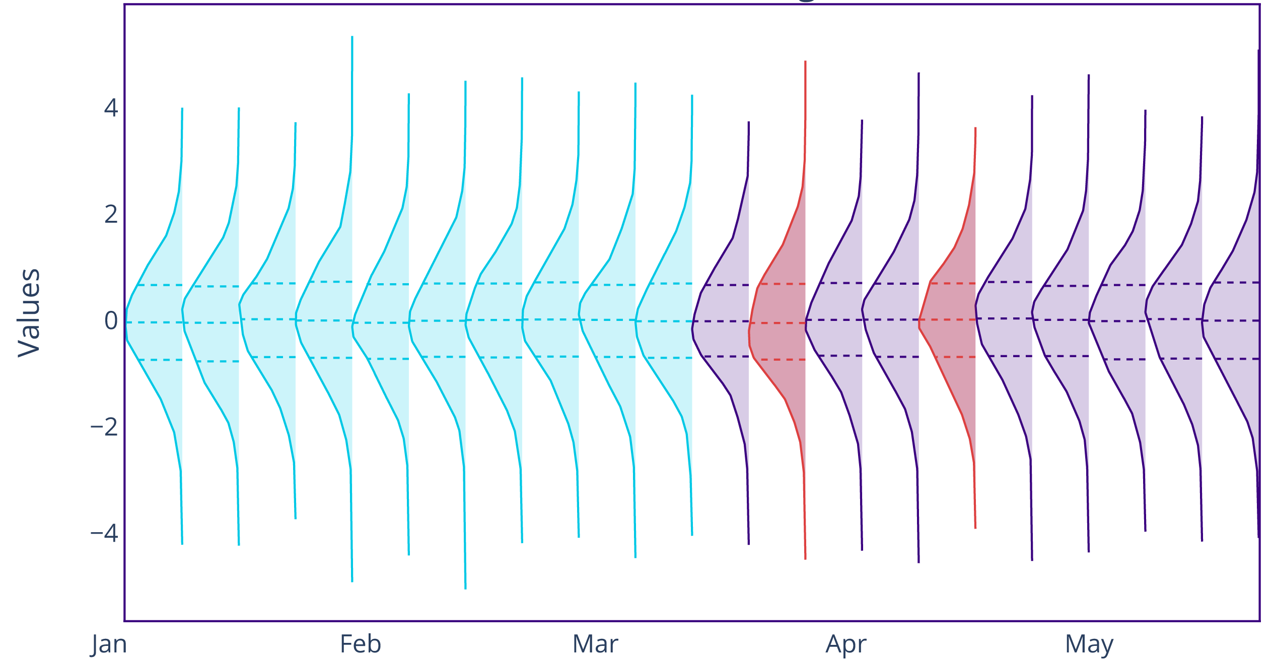
Practical Considerations
Testing Rule Stability
Temporal validation: Do rules hold across time periods?
Subset analysis: Performance across different data segments.
Sensitivity testing: How do small changes affect rules?
Business logic check: Do rules make domain sense?
>
Pg: 38
Notes:
Rule stability is crucial for practical deployment. We should test rules across different time periods, customer segments, or other natural data splits. Rules that work well in one context but fail in another are red flags. We should also perform sensitivity analysis - small changes in the data shouldn't dramatically alter our rules. Finally, every rule should pass the business logic test: does it make sense from a domain perspective? We must understand how they causally connect to the target variable.

Slide 39
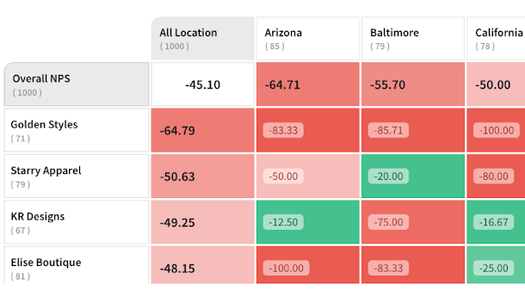
Practical Considerations
Model Error Analysis (and Cohort Analysis)
Examine reasons for false positives and negatives, and segment even true positives into cohorts, with additional data:
The customer moved or traveled for a long time to a place where the bank has no presence
The customer lost the job that was deposited to the bank
Older customers are unaware of online offerings
Single product customer satisfaction is low
Offer means to discriminate churn risk based on other possibilities
If churn risk is high , determine the root cause through additional models/data and target the customer with offer appropriately.
>
Pg: 39
Notes:
Rule stability is crucial for practical deployment. We should test rules across different time periods, customer segments, or other natural data splits. Rules that work well in one context but fail in another are red flags. We should also perform sensitivity analysis - small changes in the data shouldn't dramatically alter our rules. Finally, every rule should pass the business logic test: does it make sense from a domain perspective?

Slide 40
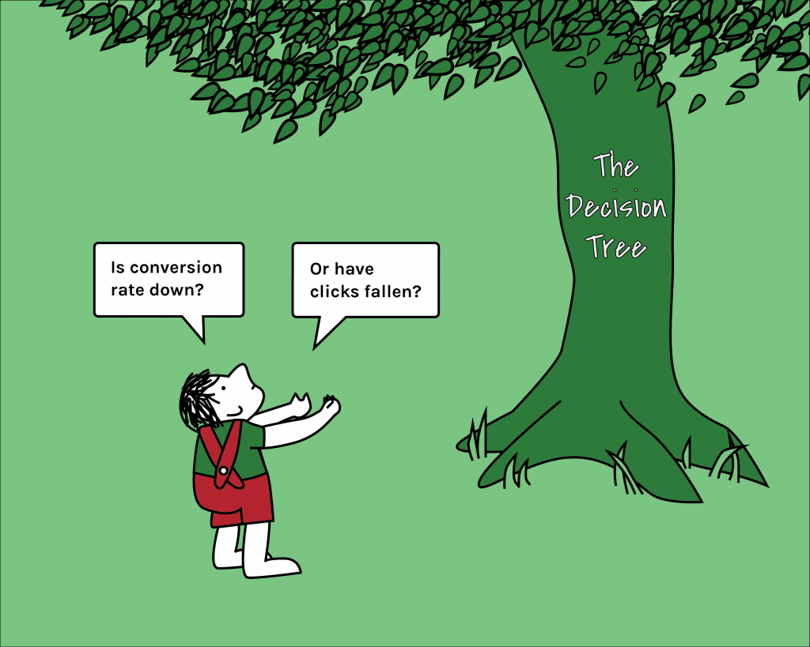
Practical Considerations
Choosing the Right Model
Decision Framework:
Accuracy priority: RuleFit or ensemble methods
Transparency priority: Simple decision trees or rule lists
Consistency priority: Rule lists with clear precedence
Flexibility priority: Rule sets with weighted voting
Stakeholder needs: Match model complexity to audience
>
Pg: 40
Notes:
Choosing the right interpretable model depends on your specific priorities and constraints. If accuracy is paramount, RuleFit often delivers the best results. If transparency is critical, simple decision trees or rule lists might be preferable even if they're less accurate. Consider your stakeholders - a rule list might be perfect for business users who need clear precedence, while data scientists might prefer the flexibility of rule sets.

Slide 41

Practical Considerations
Implementation Best Practices
Start simple: Begin with basic decision trees
Validate interpretations: Test explanations with domain experts
Document assumptions: Make model limitations clear
Monitor performance: Rules can degrade over time
Plan for updates: Have a process for rule maintenance
>
Pg: 41
Notes:
Successful deployment of interpretable models requires careful planning. Start with simple approaches and gradually increase complexity only if needed. Validate your interpretations with domain experts - they can catch rules that are technically correct but practically meaningless. Document all assumptions and limitations clearly. Most importantly, plan for ongoing maintenance - rules that work today might not work tomorrow as data patterns change.

Slide 42

Practical Considerations
Key Takeaways & Next Steps
Interpretability is achievable without sacrificing too much accuracy.
Rule-based models provide natural explanations for decisions.
Evaluation must be comprehensive - at model and rule level.
Choice depends on context - accuracy vs. transparency trade-offs.
Implementation requires discipline - validation, documentation, monitoring.
A data-driven, patient, and surgical precision approach to model-making and understanding is required to make the most out of it.
>
Pg: 42
Notes:
Let's wrap up with the key takeaways. Interpretable machine learning is not just possible - it's practical and often necessary. Rule-based models provide a natural bridge between accurate predictions and human understanding. The key is comprehensive evaluation at both model and rule levels, making thoughtful trade-offs between accuracy and transparency based on your specific context. Success requires discipline in validation, documentation, and ongoing monitoring. The tools and techniques we've discussed today can help you build models that are not just accurate, but trustworthy and actionable.

Slide 43
Thank You

